Slide 1
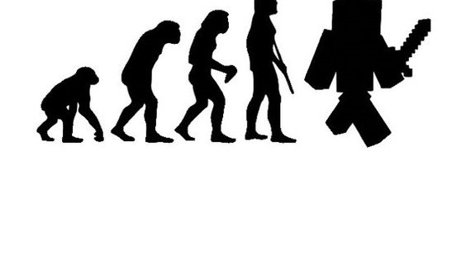
Evolving Away from Primitive Types

Slide 2

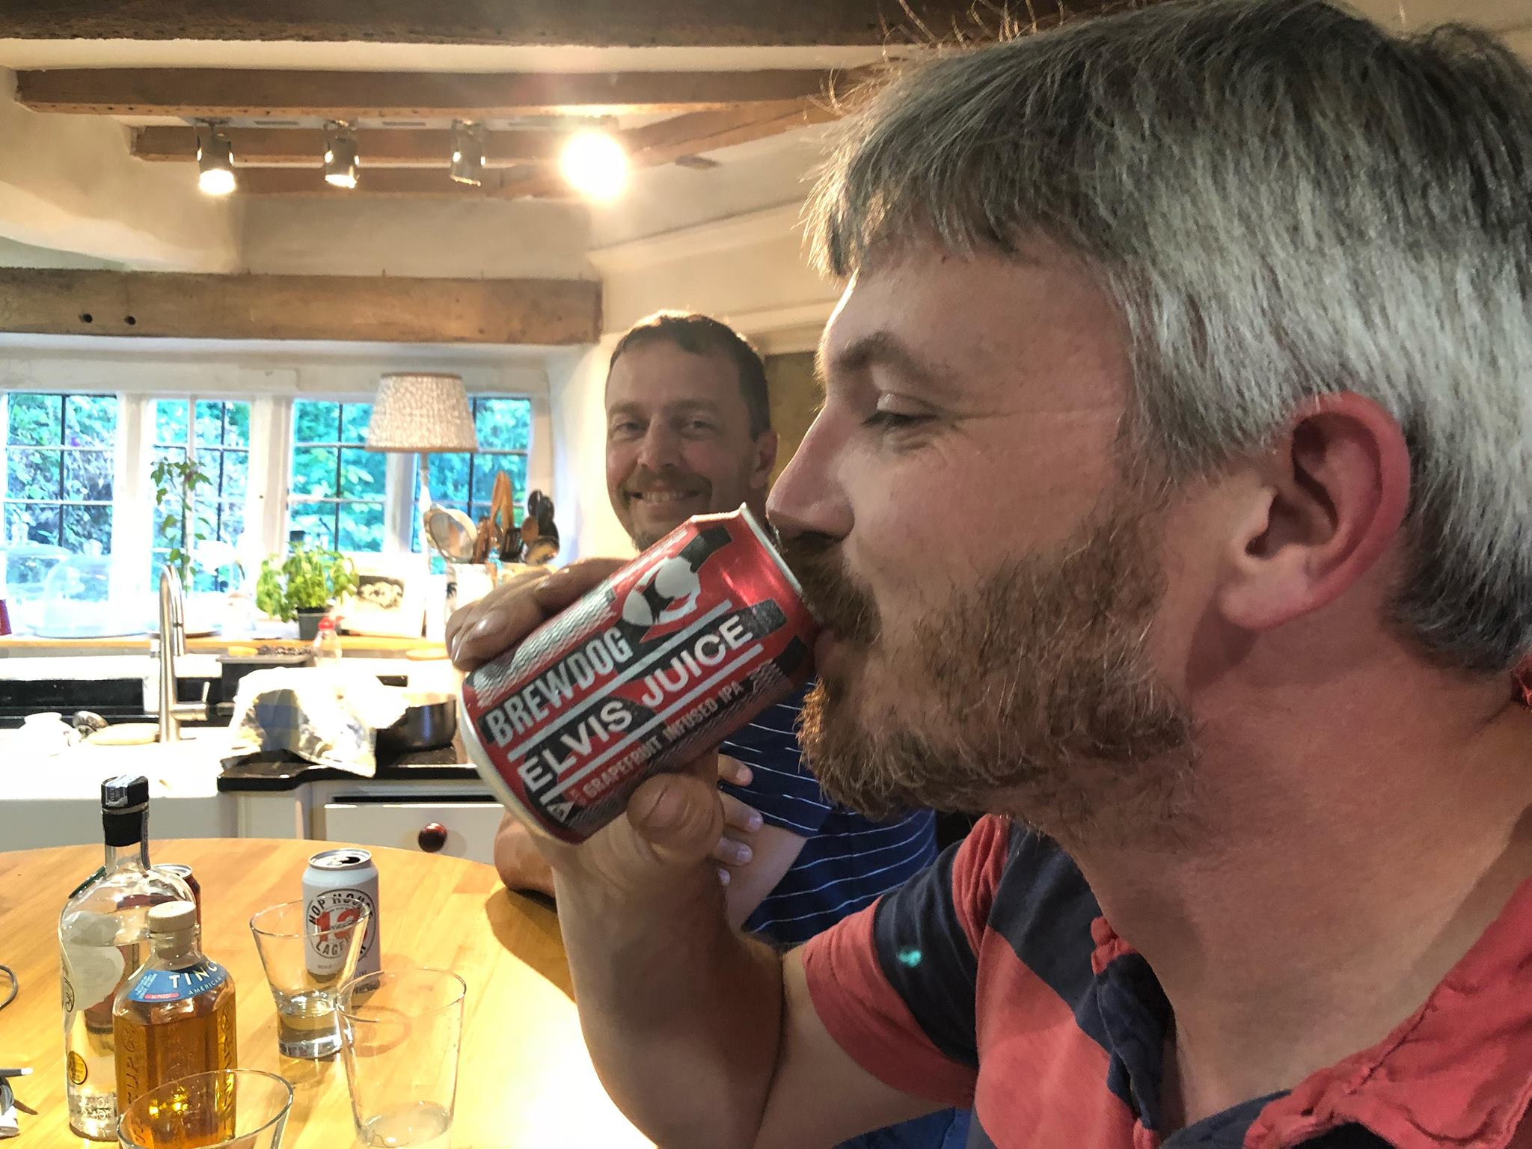
5/a
Daniel Bryars
Technical Director Speik.com
C#, C, (not JS)
>44 <46
5’11”
Undisclosed
>20 years
3714
Robotics, Raspberry Pi’s, C#, building stuff
Languages:
Age:
Height:
Weight:
Experience:
Stackoverflow points:
Interests:
about.me

Slide 3
It’s usually the simple things which trip me up.
git@github.com:DanielBryars/evolvingFromPrimitiveTypes.git

Slide 4
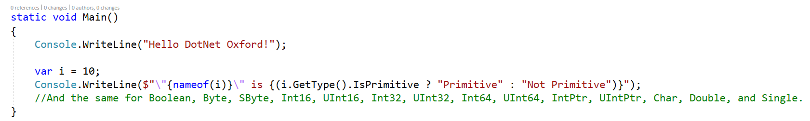
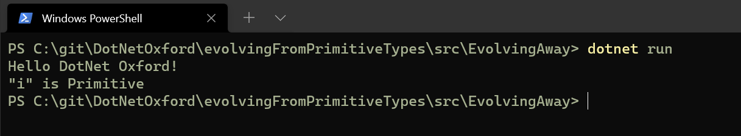
NOT
THIS

Slide 5
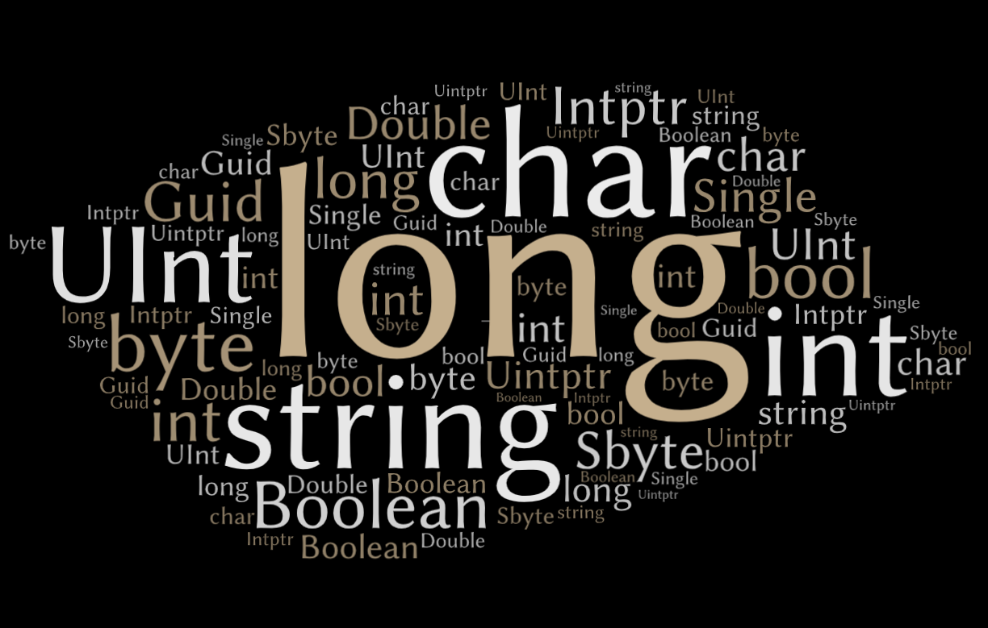

Slide 6
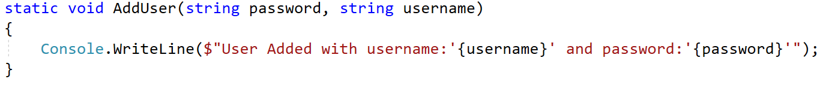

Did I pass the username as the password?

Slide 7
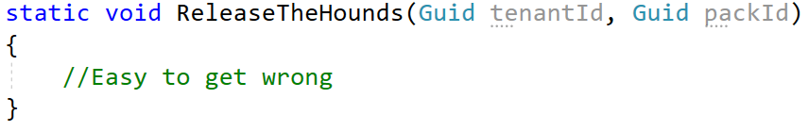
Or mix up the guids?

Slide 8
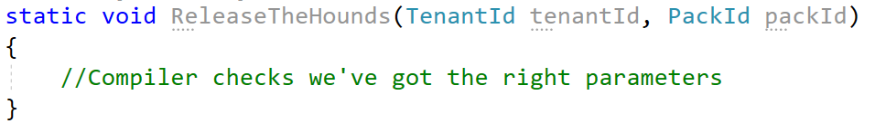

Slide 9
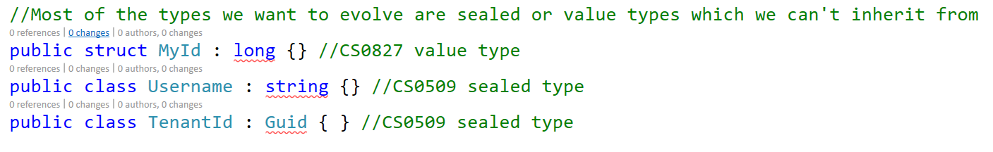

Slide 10
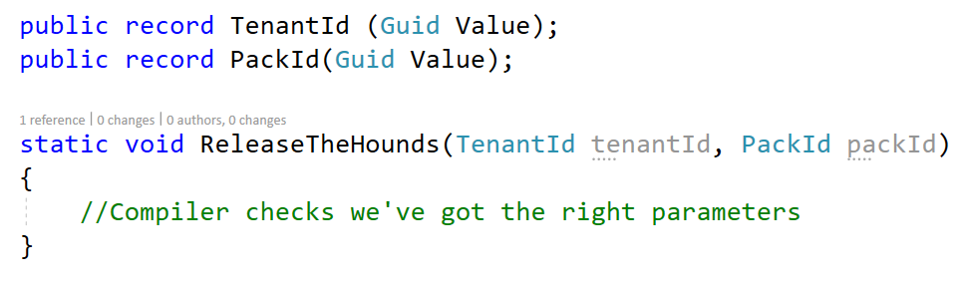

Slide 11
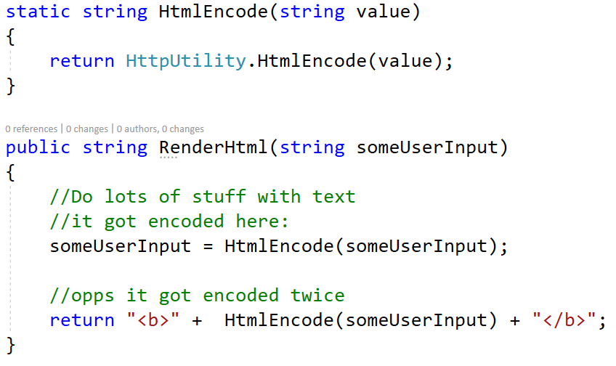

Slide 12
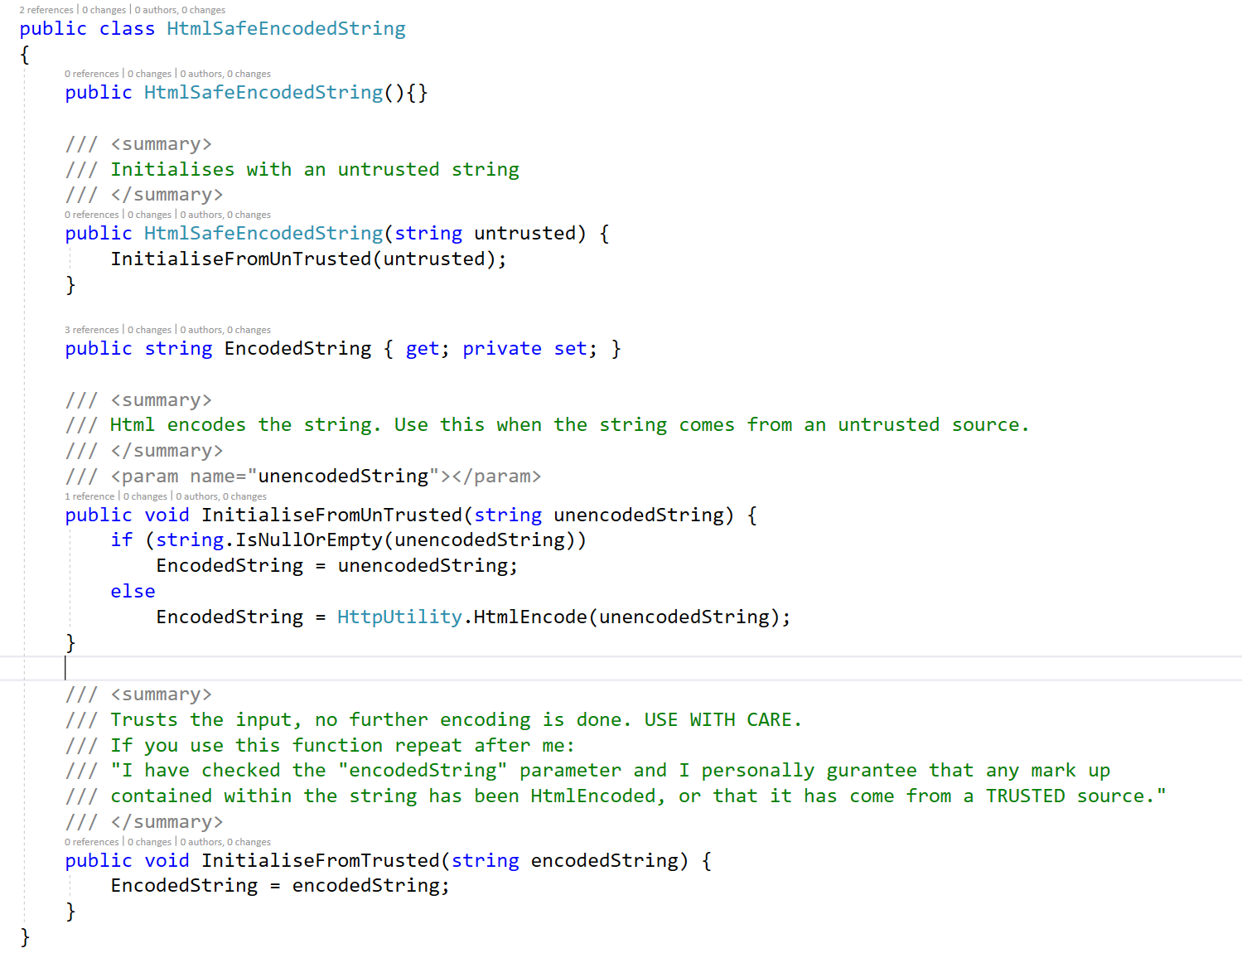

Slide 13
Do
Avoid Naked / Primitive types if it helps
Do
Use types to “know what this semantically is”
Don’t
use it too much, it can be laborious
Don’t
provide operator overloads to covert between types
Do
wish there was a strict typedef to avoid the ceremony

